Slide 1
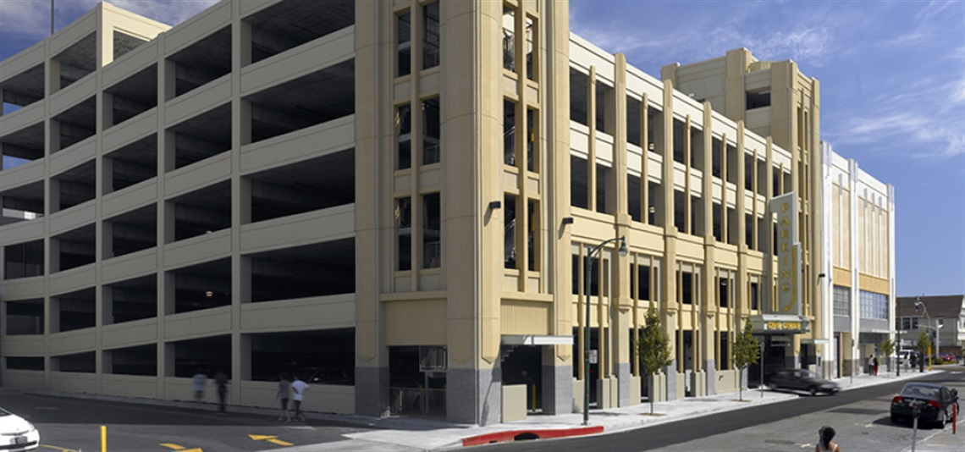

Civic Center Garage – 2008, Source: International Parking Design
Introduction of Ordinance
Employee Lot; and
Civic Center Parking Structure Hours of Operation
Alameda City Council Meeting
May 19, 2026
Notes:
Good evening Madam Mayor, Vice Mayor, and Members of the City Council. I'm Ricardo De La Torre, the City's Parking Manager.
Tonight, Council is considering the introduction of an ordinance that makes two changes to the Municipal Code related to parking. The first is a housekeeping update to remove an outdated reference to a City employee parking lot that no longer exists. The second establishes authority for the City Manager or their designee to set and modify hours of operation for the Civic Center Parking Structure.

Slide 2
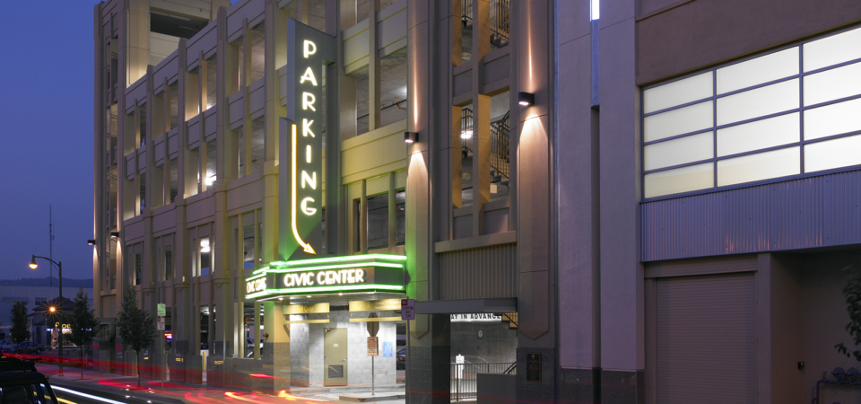

Items to Discuss
Background
Survey Results & Occupancy Data
Proposed Ordinance
Next Steps
Recommendation
Civic Center Garage – 2008, Source: International Parking Design
Alameda City Council Meeting
May 19, 2026
Notes:
Tonight I'll cover a brief background on the Civic Center Parking Structure and what's driving this request, walk through the two components of the proposed ordinance, touch on next steps if the ordinance is introduced tonight, and close with staff's recommendation.

Slide 3
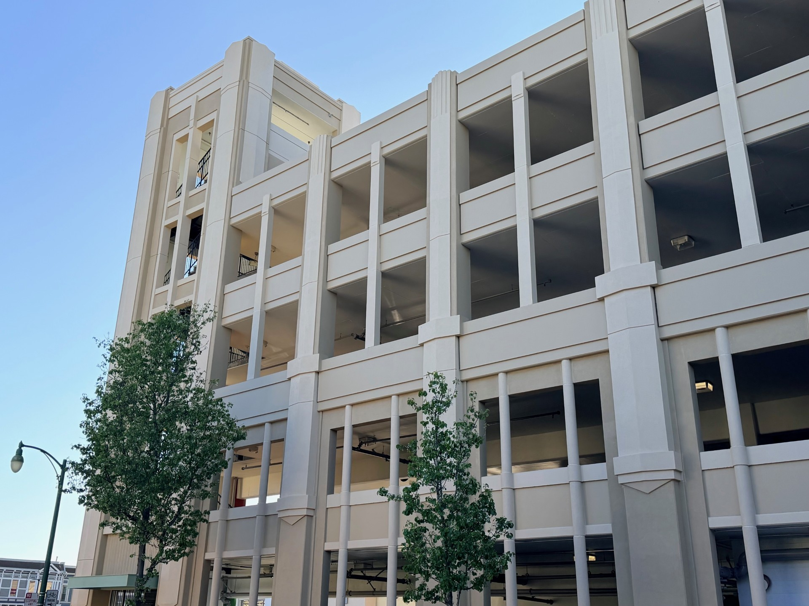
About the Civic Center Parking Structure
Parking facility that serves downtown businesses and public.
The facility cannot currently be physically closed overnight.
Improvements and security enhancements that will allow overnight closure.
Ordinance establishes the legal authority needed to set and enforce hours of operation once improvements are complete.
Civic Center Garage – April 2026
Alameda City Council Meeting
May 19, 2026
Notes:
The Civic Center Parking Structure is one of the main parking facilities serving downtown Alameda. It provides parking for the general public as well as City employees working at City Hall and nearby City facilities.
Over time, the facility experienced repeated vandalism during the overnight hours, particularly in and around the elevator, which caused ongoing disruptions to service. To address this, City Council approved funding for security enhancements and other improvements to the structure, including the ability to physically close the facility overnight.
Those improvements are now underway, and we will soon be ready to close the facility overnight. The ordinance before you tonight would vest the authority to set and modify operating hours with the City Manager or their designee, giving the City the legal foundation it needs to manage and enforce those hours going forward.
Based on outreach we conducted and a review of what comparable cities do, the hours we intend to implement once the facility can be closed overnight are midnight to 6:00 a.m. I’ll walk through that data in a moment.

Slide 4
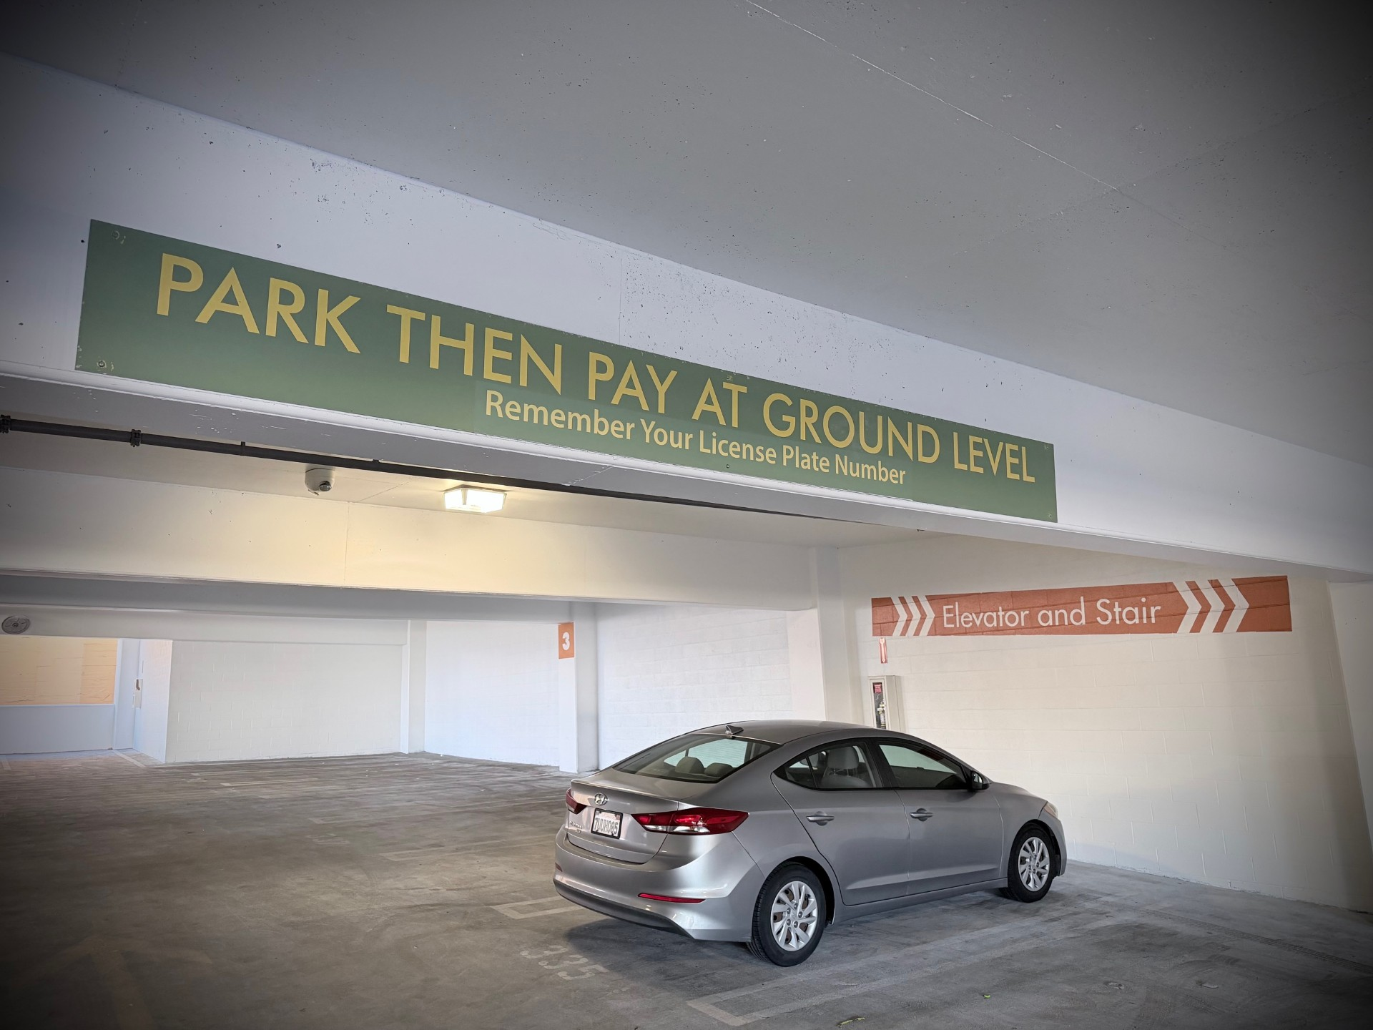
What the Data Tells Us
550+
>70%
~3%
Survey responses received
Vacancy in surrounding downtown area overnight
Avg. overnight occupancy in the garage (10 pm – 2 am)
Survey respondents preferred closing at midnight and reopening at 6:00 a.m.
Comparable cities reviewed: Berkeley, San Leandro, and Emeryville — most close overnight at midnight.
Occupancy counts collected over three weeks on weekdays and weekends between 10:00 p.m. and 2:00 a.m.
Civic Center Garage, 3rd floor – April 2026
Alameda City Council Meeting
May 19, 2026
Notes:
To inform the decision around hours of operation, staff took several steps.
First, we surveyed garage users. More than 550 responses were received. Most respondents indicated a preference for closing at midnight and reopening at 6:00 a.m.
We also looked at what comparable cities are doing. Staff reviewed parking structures in Berkeley, San Leandro, and Emeryville. These facilities generally close overnight, with most closing at midnight.
Finally, staff conducted late-night parking occupancy counts over a three-week period at the Civic Center structure and surrounding downtown locations. Data was collected between 10:00 p.m. and 2:00 a.m. on both weekdays and weekends. The results showed that the Civic Center structure was operating at an average occupancy of about three percent during those hours, while the surrounding downtown area within a five-block radius had over 70 percent vacancy.
Taken together, the data supports closing the facility overnight. And consistent with the survey results and what comparable cities do, the hours we plan to implement are midnight to 6:00 a.m.

Slide 5
Proposed Ordinance – Two Components
Component 1 – Housekeeping Update (Section 12-2.3)
Removes an outdated reference to 2216 Lincoln Avenue as a City employee parking lot. That site no longer exists and has been redeveloped.
Component 2 – Civic Center Parking Structure Operations (Section 12-4.12)
Authorizes the City Manager or designee to establish and modify hours of operation.
Requires hours to be posted on-site.
Makes it unlawful to park or leave a vehicle outside of posted hours without authorization.
Vehicles left outside posted hours are subject to citation or enforcement action.
Alameda City Council Meeting
May 19, 2026
Notes:
The proposed ordinance has two components.
The first is a housekeeping amendment to Section 12-2.3 of the Municipal Code, which currently references 2216 Lincoln Avenue as a City employee parking lot. That lot no longer exists, the site has since been redeveloped. This change simply removes that outdated reference.
The second component repeals and replaces Section 12-4.12 of the Municipal Code to formally establish the City Manager's authority to set and modify hours of operation for the Civic Center Parking Structure.
Key provisions include:
Authorizing the City Manager or their designee to establish and modify hours as needed to support public safety, maintenance, and efficient operations.
Requiring that hours of operation be posted on-site.
Establishing that it is unlawful to park or leave a vehicle in the facility outside of posted hours, unless authorized.
Providing that vehicles left outside of posted hours are subject to citation or other enforcement action.

Slide 6
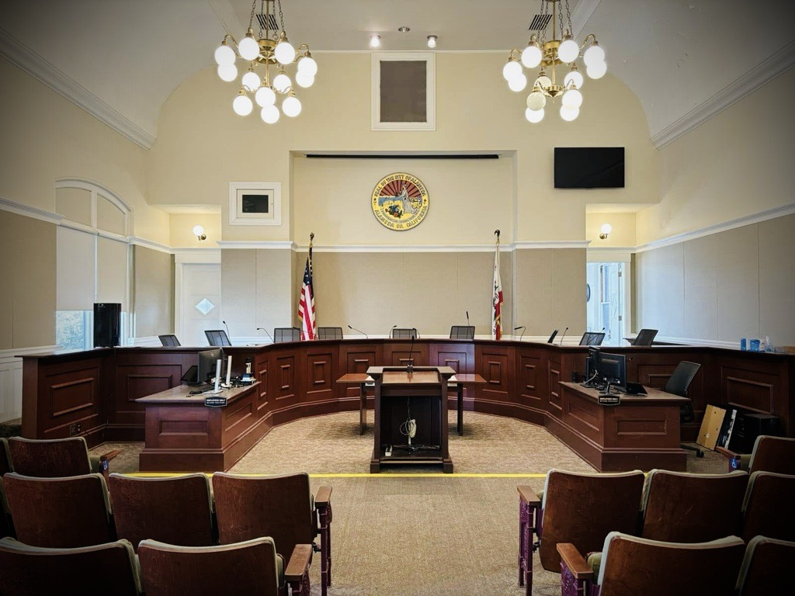
Next steps
1
First Reading
May 19, 2026
2
Final Passage
June 2, 2026
3
Effective Date
July 3, 2026
4
Improvements Complete
Staff will align new hours with completion of Civic Center Security Enhancements
Alameda City Council Meeting
May 19, 2026
Notes:
If Council introduces the ordinance this evening, the next step would be a second reading or final passage on May 19, 2026. If adopted, the ordinance would take effect 30 days after that second reading.
Following the effective date, staff will align any changes to operating hours with the completion of the Civic Center Parking Garage improvements. Before any new hours go into effect, staff will conduct outreach and education to make sure garage users are aware of the change.

Slide 7
Staff Recommendation
Approve the first reading of the Ordinance Amending the Alameda Municipal Code by Amending Section 12-2.3 (Location) of Article I (Parking Lots) of Chapter XII (Designated Parking) and by Repealing and Replacing Current Section 12-4.12 (Reserved) of Article I (Parking Lots) of Chapter XII (Designated Parking) in its Entirety to Authorize the City Manager or Their Designee to Establish and Modify Hours of Operation for the Civic Center Parking Structure.
Alameda City Council Meeting
May 19, 2026
Notes:
Staff recommend approving the first reading of the Ordinance Amending the Alameda Municipal Code by Amending Section 12-2.3 (Location) of Article I (Parking Lots) of Chapter XII (Designated Parking) and by Repealing and Replacing current Section 12-4.12 (Reserved) of Article I (Parking Lots) in its entirety to Authorize the City Manager of their designee to Establish and Modify Hours of Operation for the Civic Center Parking Structure.
Thank you. I'm happy to answer any questions.

