Slide 1
City Master Fee Schedule amendment to Add a Parking Citation Fine
Public Hearing
January 21, 2025
City Council mEeting

Slide 2
DAYLIGHTING LAW
Effective 2025, AB 413 bans vehicle parking within 20 feet of the vehicle approach side of a crosswalk to make intersections safer for pedestrians.
The law applies whether the crosswalk is marked or unmarked and regardless of if the curb is painted red.
The parking ban is reduced to 15 feet of any crosswalk with a curb extension.

Slide 3
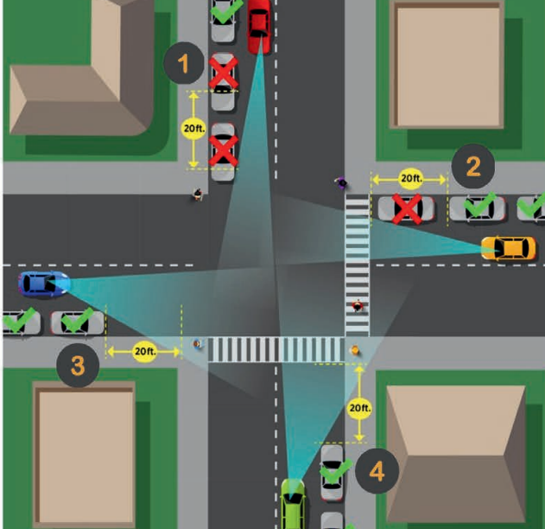
How it works
Leaving a clearance of 20 feet provides a greater field of visibility for all roadway users (as shown in scenarios #3 and #4), whereas not providing that clearance greatly reduces the visibility (as shown in scenarios #1 and #2 to the left)
3

Slide 4
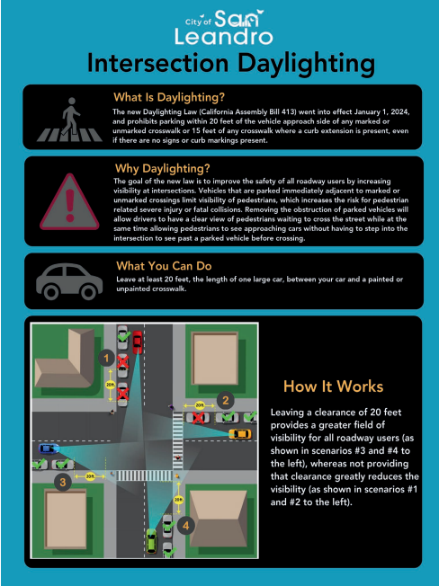
Public outreach
Daylighting Law outreach included:
• Promotion to the local press (Television, Radio, Print and Online)
Full Page Ad in the San Leandro Times (12/12/24 Edition)
Promotion on the City of San Leandro's social media pages (Facebook, Instagram, LinkedIn, and Nextdoor)
Public Service Announcement Video to be promoted using paid advertising through Google/YouTube
4

Slide 5

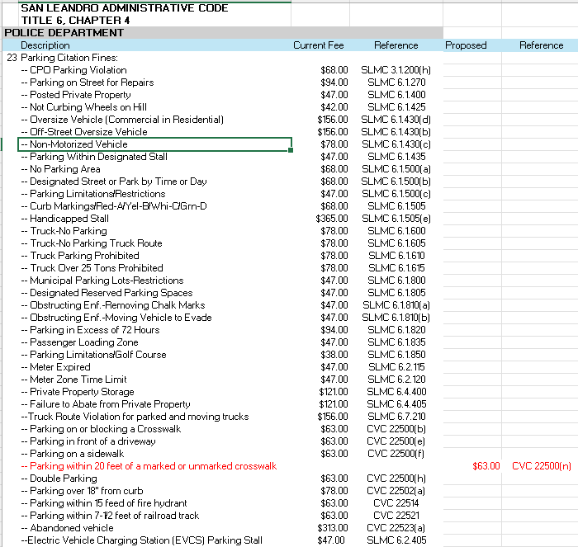
PARKING CITATION FINE
A NEW FINE OF $63.00 FOR PARKING WITHIN 20 FEET FROM A MARKED OR UNMARKED CROSSWALK IS PROPOSED
5

Slide 6
Recommendation
Open Public Hearing
Take Public Comments
Close Public Hearing
Adopt resolution to amend Title 6, Chapter 4 of the San Leandro Administrative Code to Add a Parking Citation Fine for the New California Vehicle Code Violation

